Slide 1

ITERATION 2
PRESENTATION
Team 4

Slide 2
TABLE OF CONTENTS
01
02
03
THIS
ITERATION
OUR PROCESS
NEXT STEPS
High Level summary of the what we did for this iteration
Advancements in the project, as well as any roadblocks and how we fixed them
For the next iteration. What do we hope to accomplish?

Slide 3
THIS ITERATION
01

Slide 4
REORGANIZATION OF ROLES
—RYAN BURNS
—IGNACIO MORAL
—CHRISTOL YU
—ZAHIT ODABAS
—NIVAN HANJURA
—YOUQING TSAO (TSING)
Team Leader
Requirements Leader
Configuration Leader
QA Leader
Design and Implementation Leader
Security Leader

Slide 5

REVIEWING OUR GOALS
In accordance to the previous iterations, we set out some goals that we hoped to achieve by this iteration.
Did we achieved them?

Slide 6

GOALS CHECK
Implement the design into our codebase?
Doctor/ Prescriber Page?
Follow the Security Guidelines we created?
Implement the Backend Interaction?
Users, Items, and Prescriptions

Slide 7
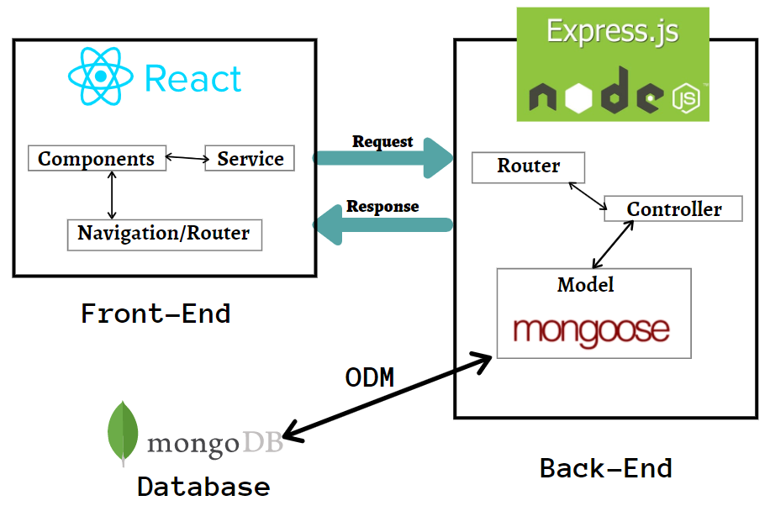
ARCHITECTURE

Slide 8



UNDERSTANDING THE PROBLEM
FRONT END
BACK END
Figma Design followed into the Front End
Advances in the Database has been notable. We achieved Item, Prescription, and User for the API.

Slide 9
SUMMARY
REFACTORING
FRONTEND
BACKEND
TESTING
Removing Code Smells from the Previous Iteration.
Advances in Frontend to look more like Figma Design
CRUD Actions and
Functionality Implementation
Constant Testing and implementation of TDD

Slide 10
OUR PROCESS
02

Slide 11
Commit Hooks (Rules about Commits, every commit uses different values {init, feat, fix, working, etc...}
eslint (verify the code (errors))
Front End
request interceptor
Business Feature {Home Page, Sign In, Sign Out, Shopping Page}
Back End
MongoDB CLOUD Database
MiddleWare {Error Handler}
Unify Response {Status, message, data}
Test {Unit Test, Coverage Test}

Slide 12

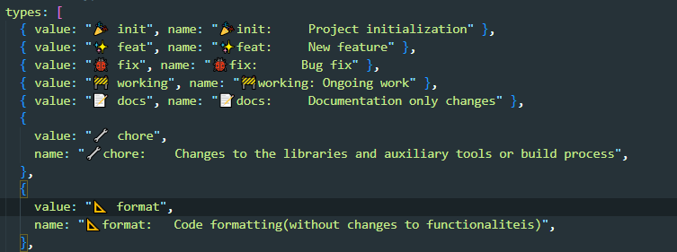

COMMIT HOOKS & ESLINT

Slide 13
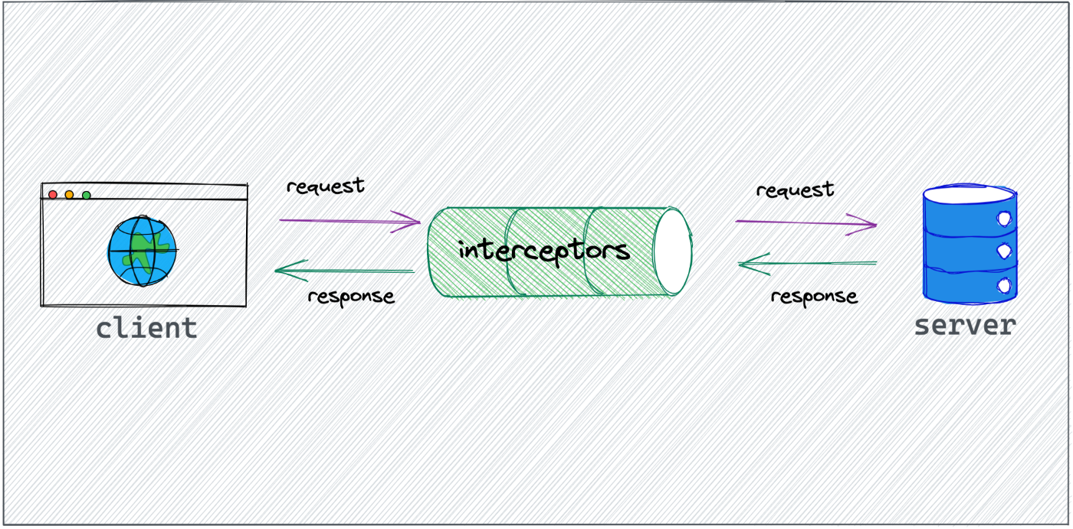

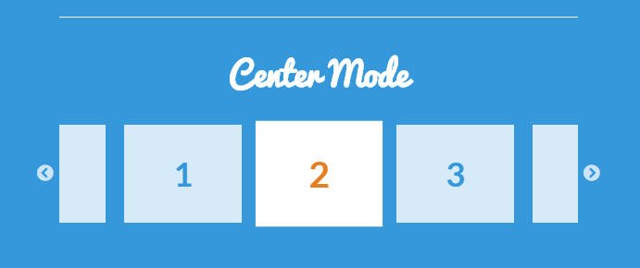

FRONT END

Slide 14
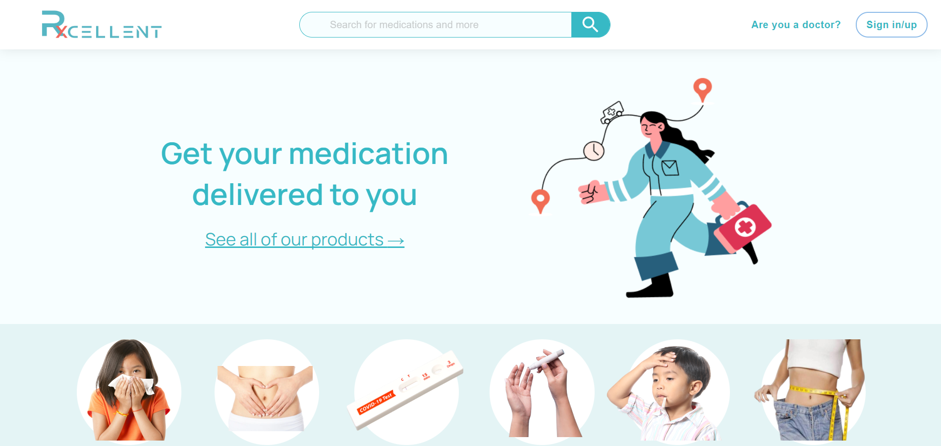
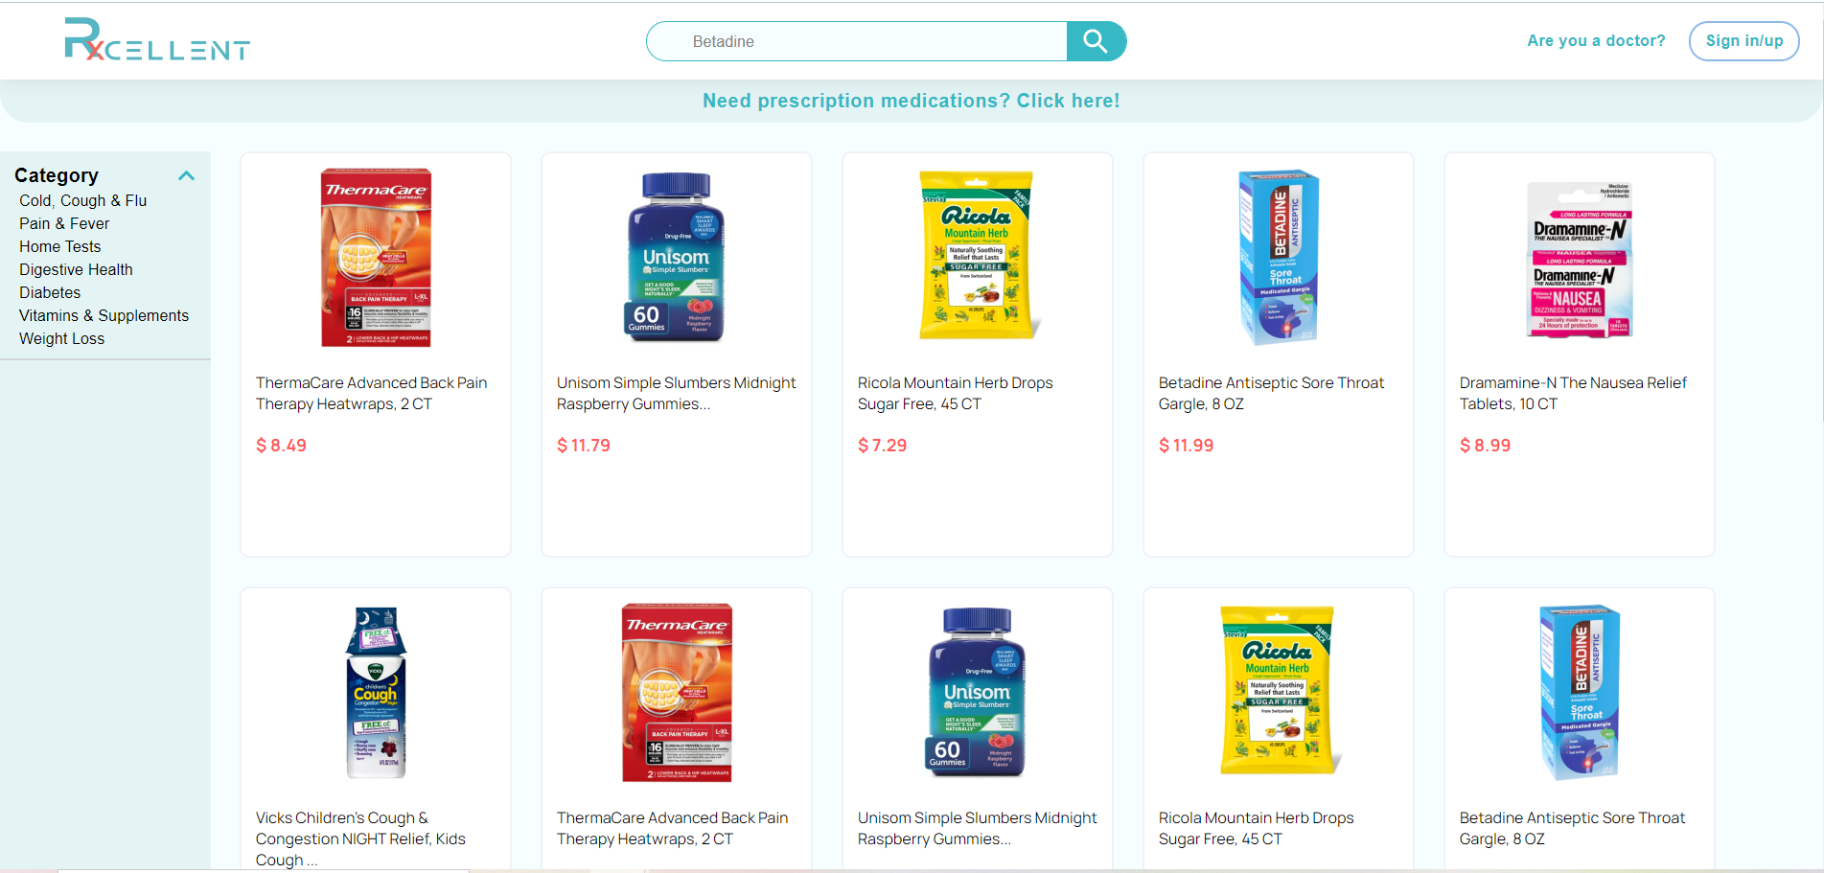
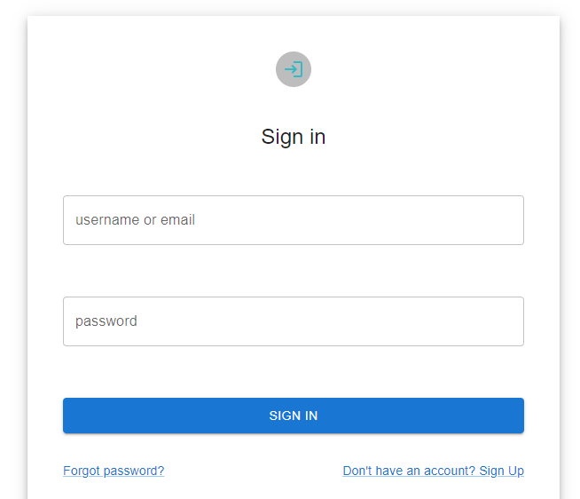
FRONT END

Slide 15

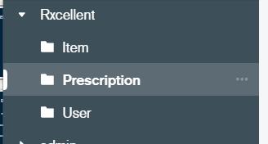


BACK END

Slide 16
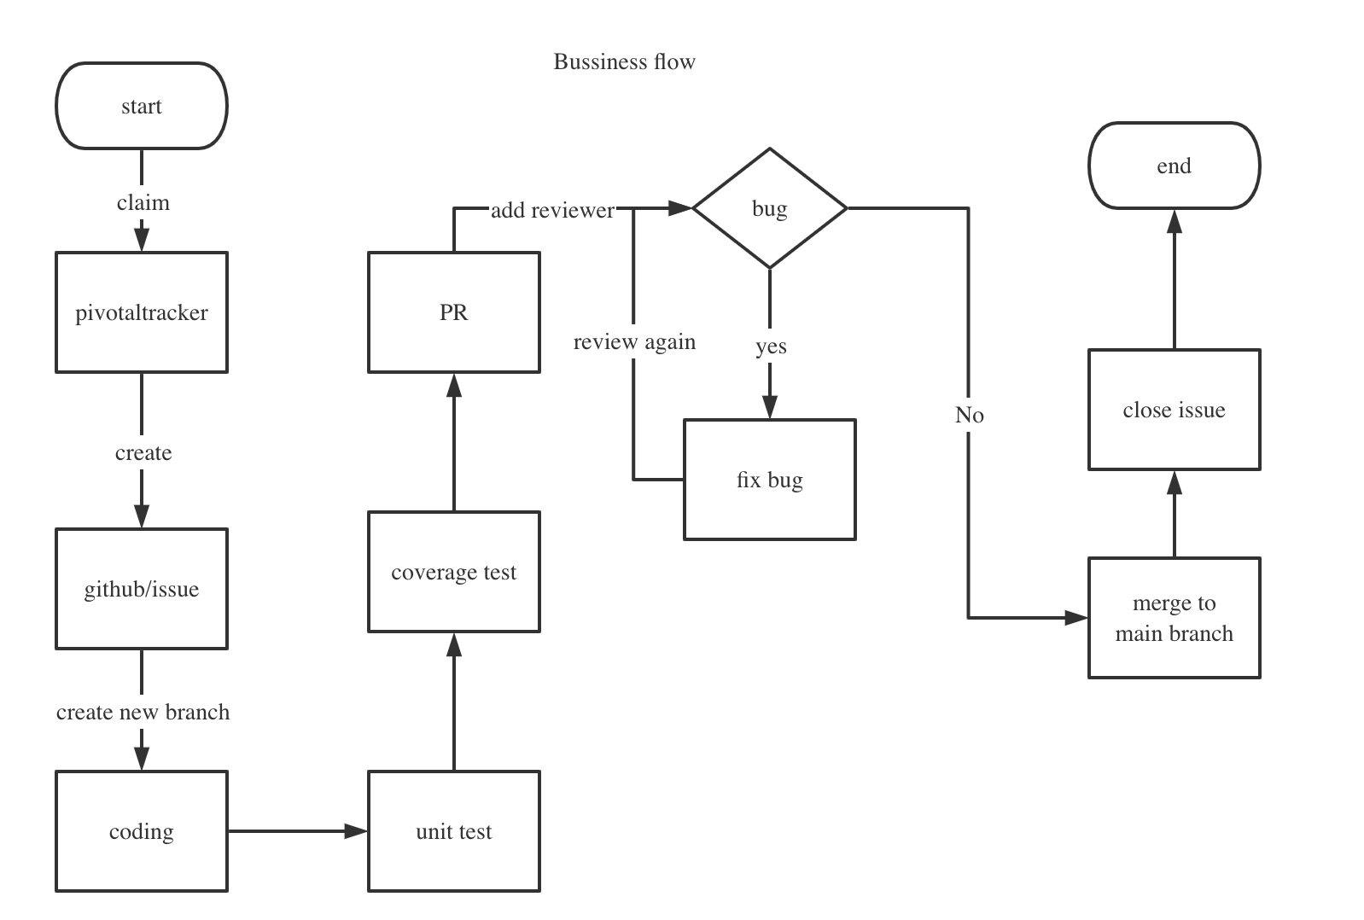
Business Flow

Slide 17
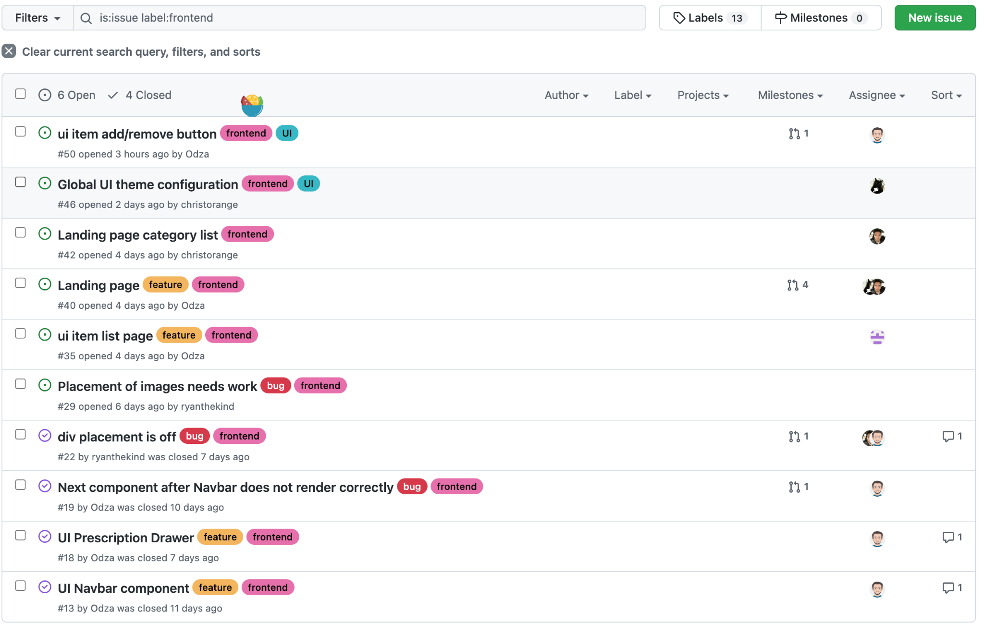
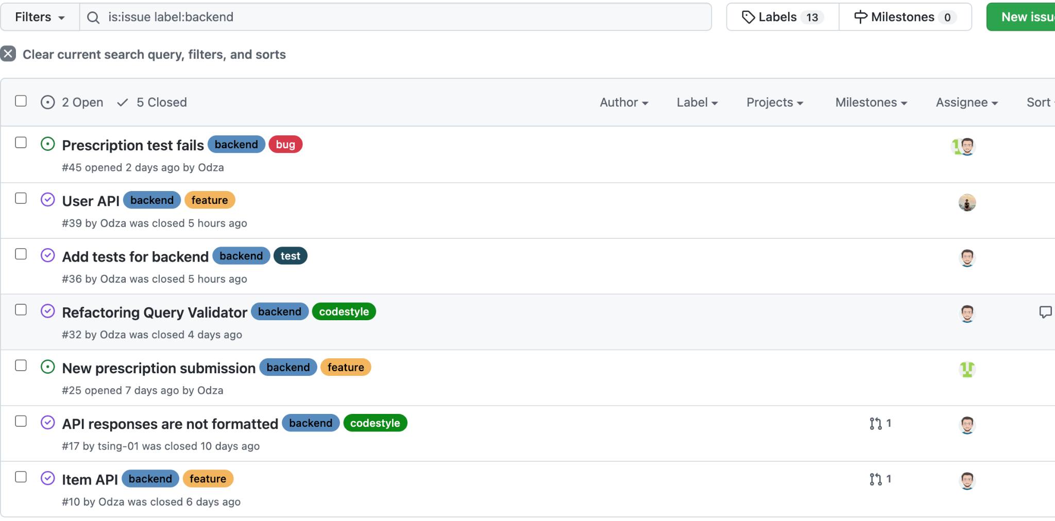
Issue management
https://github.com/BUMETCS673/group-project-team4-js/issues

Slide 18

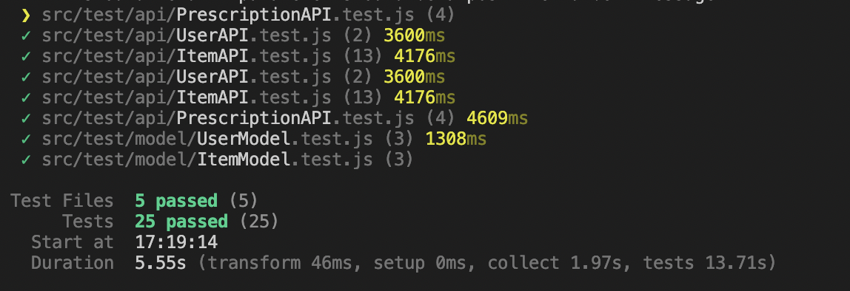
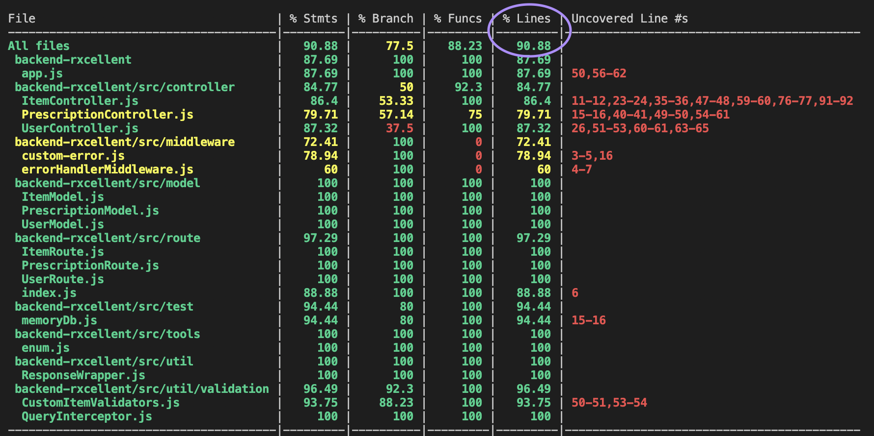
Testing
Item
User
Prescription
Unit Testing
Coverage Testing
All Files

Slide 19
NEXT STEPS
03

Slide 20
NEXT STEPS
interaction
FINALIZATION
features
TESTING
PRESENTATION
sendEmail
Payment
User information management
Feedback
Delivery
Testing, testing, testing.
Group Presentation
Deploy: amazon cloud
Git hooks + nginx
Finish all interface interaction.

Slide 21


AS A TEAM…
When we work together, we stay together!

Slide 22
THANKS
Do you have any questions?
Please keep this slide for attribution

